Slide 1

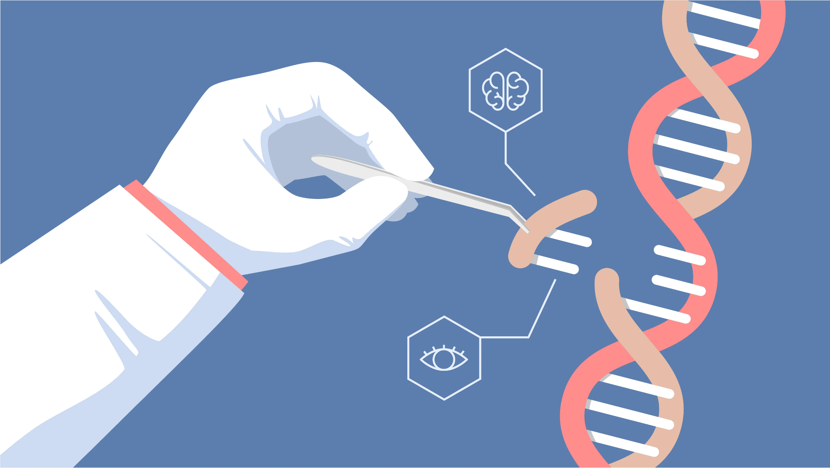
CRISPR
Mohammad Rostami, Mohammad Hossein Rohban, Hamid Reza Rabiee, Mohsen Sharifitabar
Notes:
Thank Dr, Rabiee, Rohban, Sharifitabar, Ghereh, Hamed Dashti
Ask me question cause it seems obvious to me, I forget shit

Slide 2
What is Clustered Regularly Interspaced Short Palindromic Repeats?
Notes:
تناوب‌هایِ کوتاهِ پالیندرومِ فاصله‌دارِ منظمِ خوشه‌ای

Slide 3
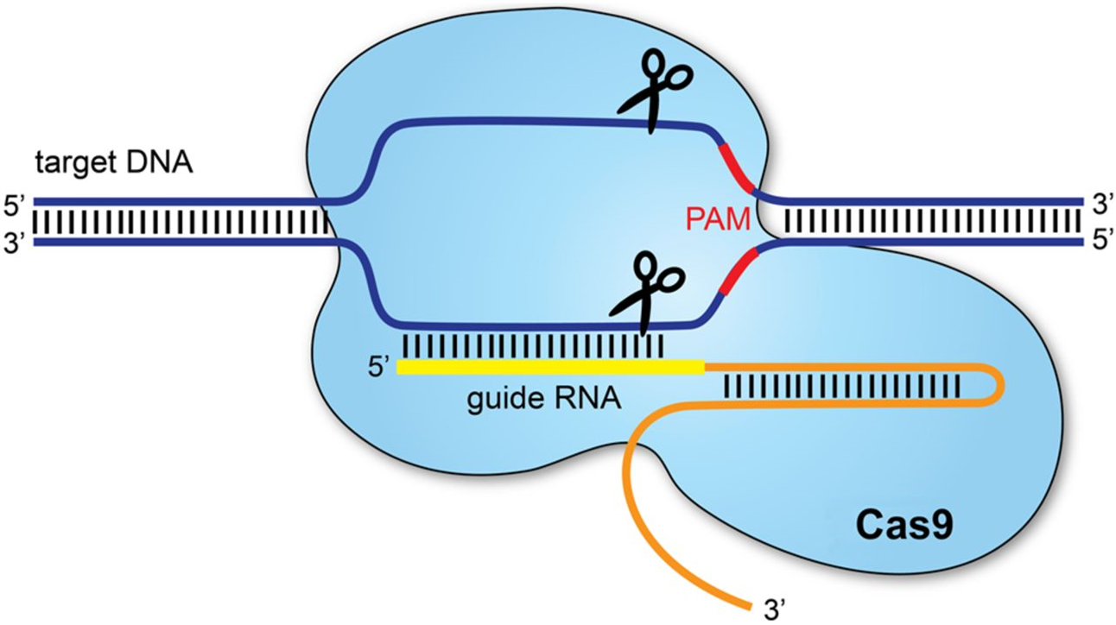
CAS9 (protein) + GUIDE RNA (sgRNA or gRNA)
Notes:
Edit DNA first found in bacteria,
CAS9 Protein+RNA sequence+ some parts more important part sgrna,
Cas9 meseh zip open dna ,
sgrna find targets,
and the pam seq inside grna cuts

Slide 4
How does CRISPR Functions?

Slide 5
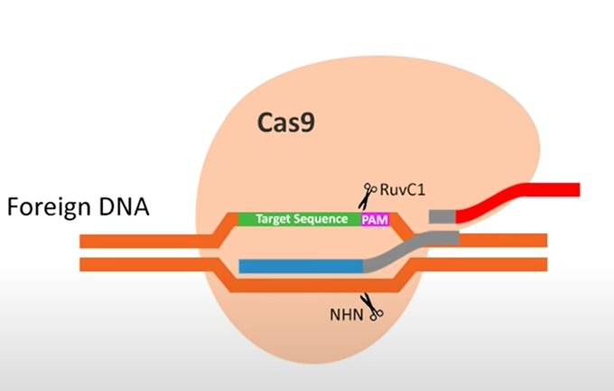
CRISPR Edits the DNA
Notes:
Like a zip came here,
found its target and edited

Slide 6
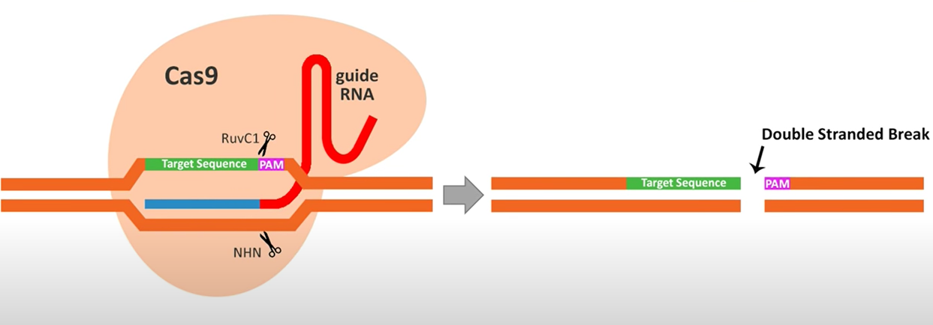

Slide 7
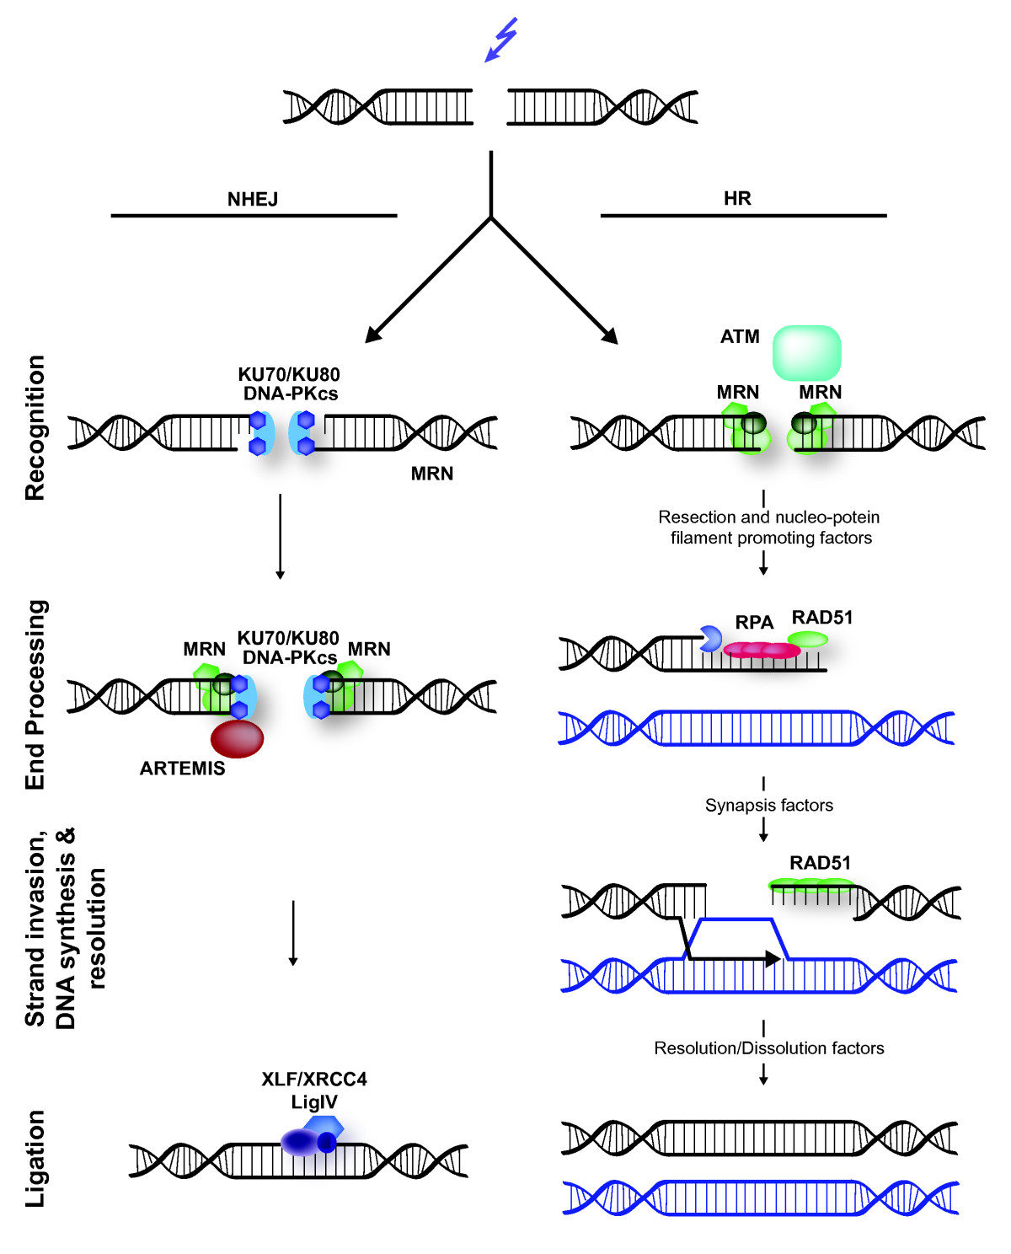
NHEJ
Efficient but error-prone
Usual method used for repairing DNA
But after repair probably two different thus remove it
HDR
Efficiency of HDR relates to the DISTANCE and the MUTATION
Don’t give exact PAM for a repair will increase efficiency
Notes:
Bind with or without a template

Slide 8
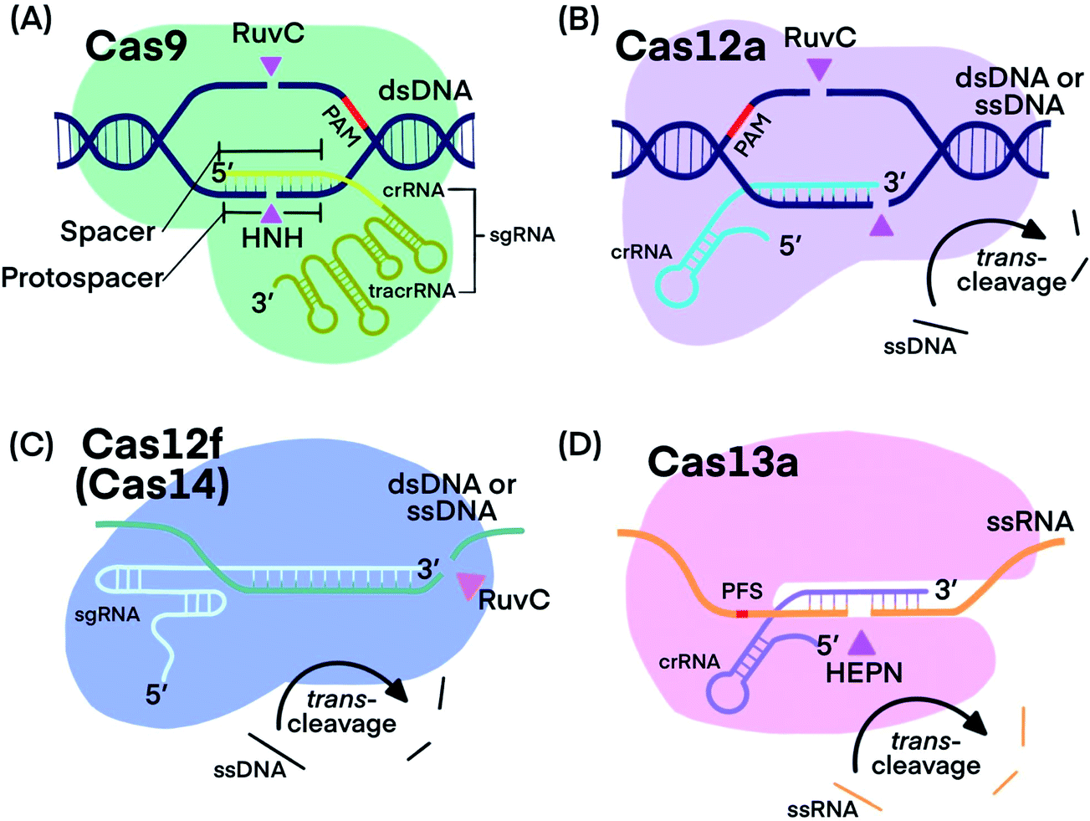
CAS9
Temporary disabling the bond between the backbones of a DNA
Different variants have been engineered (dcas9, snipercas9, etc)
Notes:
Better cas with more efficiency,

Slide 9
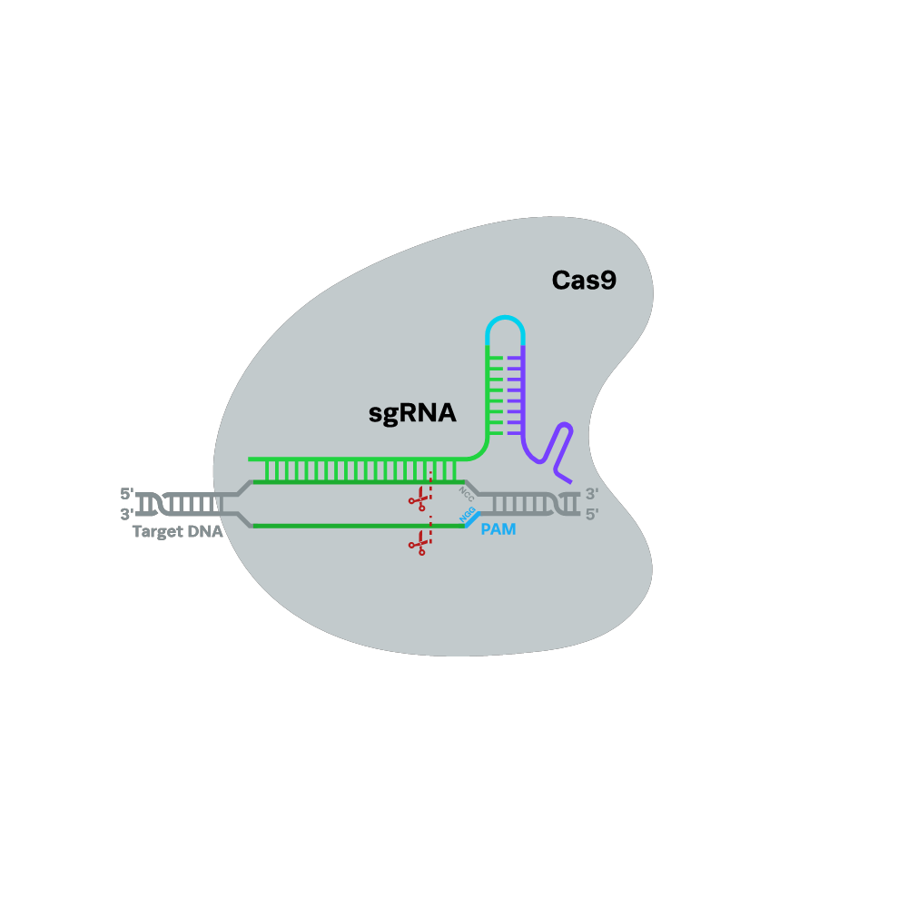
gRNA
SCAFFOLDING (binds to cas9) + SPACER (binds to PAM) + PAM
Notes:
Not interesting parts,
and defined by sgRNA
For one task U can have multiple sgrnas, PAM indicates the number of possible sgrnas

Slide 10
How Can We Make CRIPSR?

Slide 11
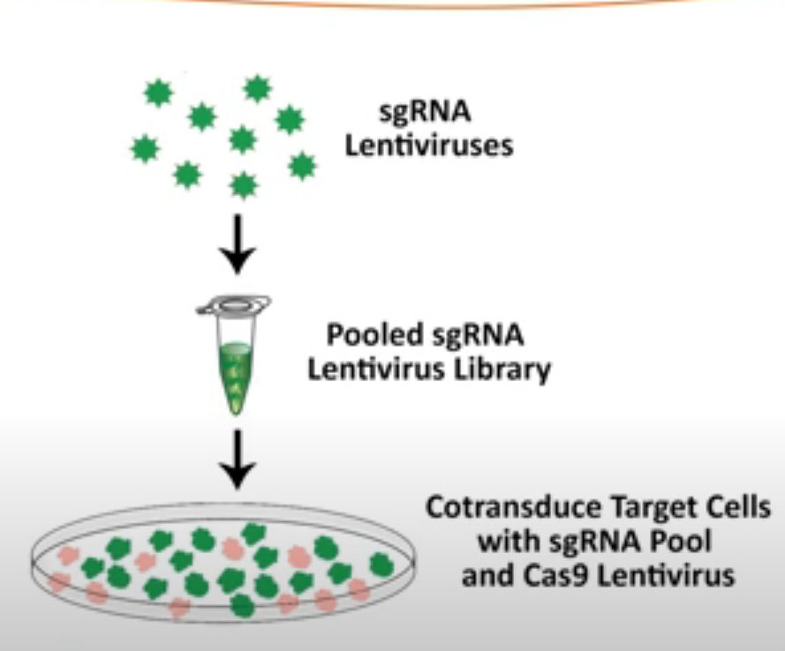

Slide 12
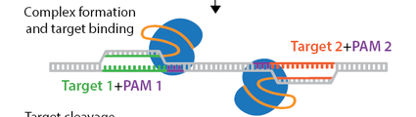
Efficiency Specificity
Two grRNA instead of one
Mismatch in PAM
Self-Complementary
The accessible DNA is more amenable to cutting with Cas9
The influence of sequence composition
The position of specific nucleotides in the target sequence
The flanking regions
DSB repairs will give rise to a frameshifting mutation
Paired nickase experiments.
Mismatches are tolerant at PAM
Single mismatches up to 11 bp from the 5’ of PAM abolish cleavage
4 or more mismatches won't initiate cleavage
Pruncated sgRNAs to increasing specificity and the targeting range
Notes:
To do a recap and state where ml comes in!
On-target
But also another problem arise which we are not yet conserned with

Slide 13
Related Works
Notes:
Bio scientist want a ranking of best sgrnas for editing a part,
what sgrnas they have?
Rank them
offtarget

Slide 14
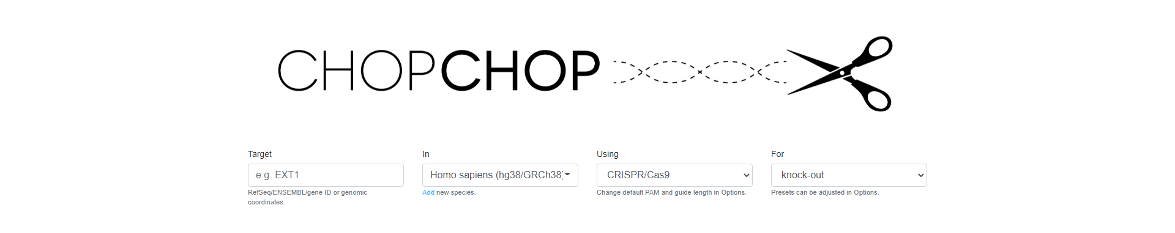
Inputs: GeneID, Sequence with Coordinates
On-Target Scoring: Doench et al. 2014-2016; Chari et al. 2015; Xu et al. 2015; Moreno-Mateos et al. 2015; G20
Off-Target Scoring: MIT specificity score; Cong et al., 2013
Notes:
Update a couple of times

Slide 15
Ranking
BOWTIE: finding alignment
PRIMER3: finding suitable primers
Ranking design:
(I) #off-targets in genome
(II) Perfect mismatch
(III) architecture of the gene
(IV) GC-Content
(V) G in 20th position
(VI) position in gene
Notes:
ranked by: (i) the number of off-targets, (ii) whether the off-targets contain mismatches or are perfect hits, and (iii) where the target site lies within the architecture of the gene (many users wish to create a frameshift/null mutation and therefore will prefer a mutation at the 5′ end of the gene). Additionally, for CRISPR/Cas9 mode the results are ranked by (iv) GC-content. Recent reports suggest that sgR- NAs are most effective with a GC-content between 45 and 80%, and (v) a guanine at position 20 in the target site, which is associated with improved activity
CHOPCHOP determines potential off-target sites for all sgRNAs using Bowtie (26) and automatically generates primers for target sites using Primer3

Slide 16
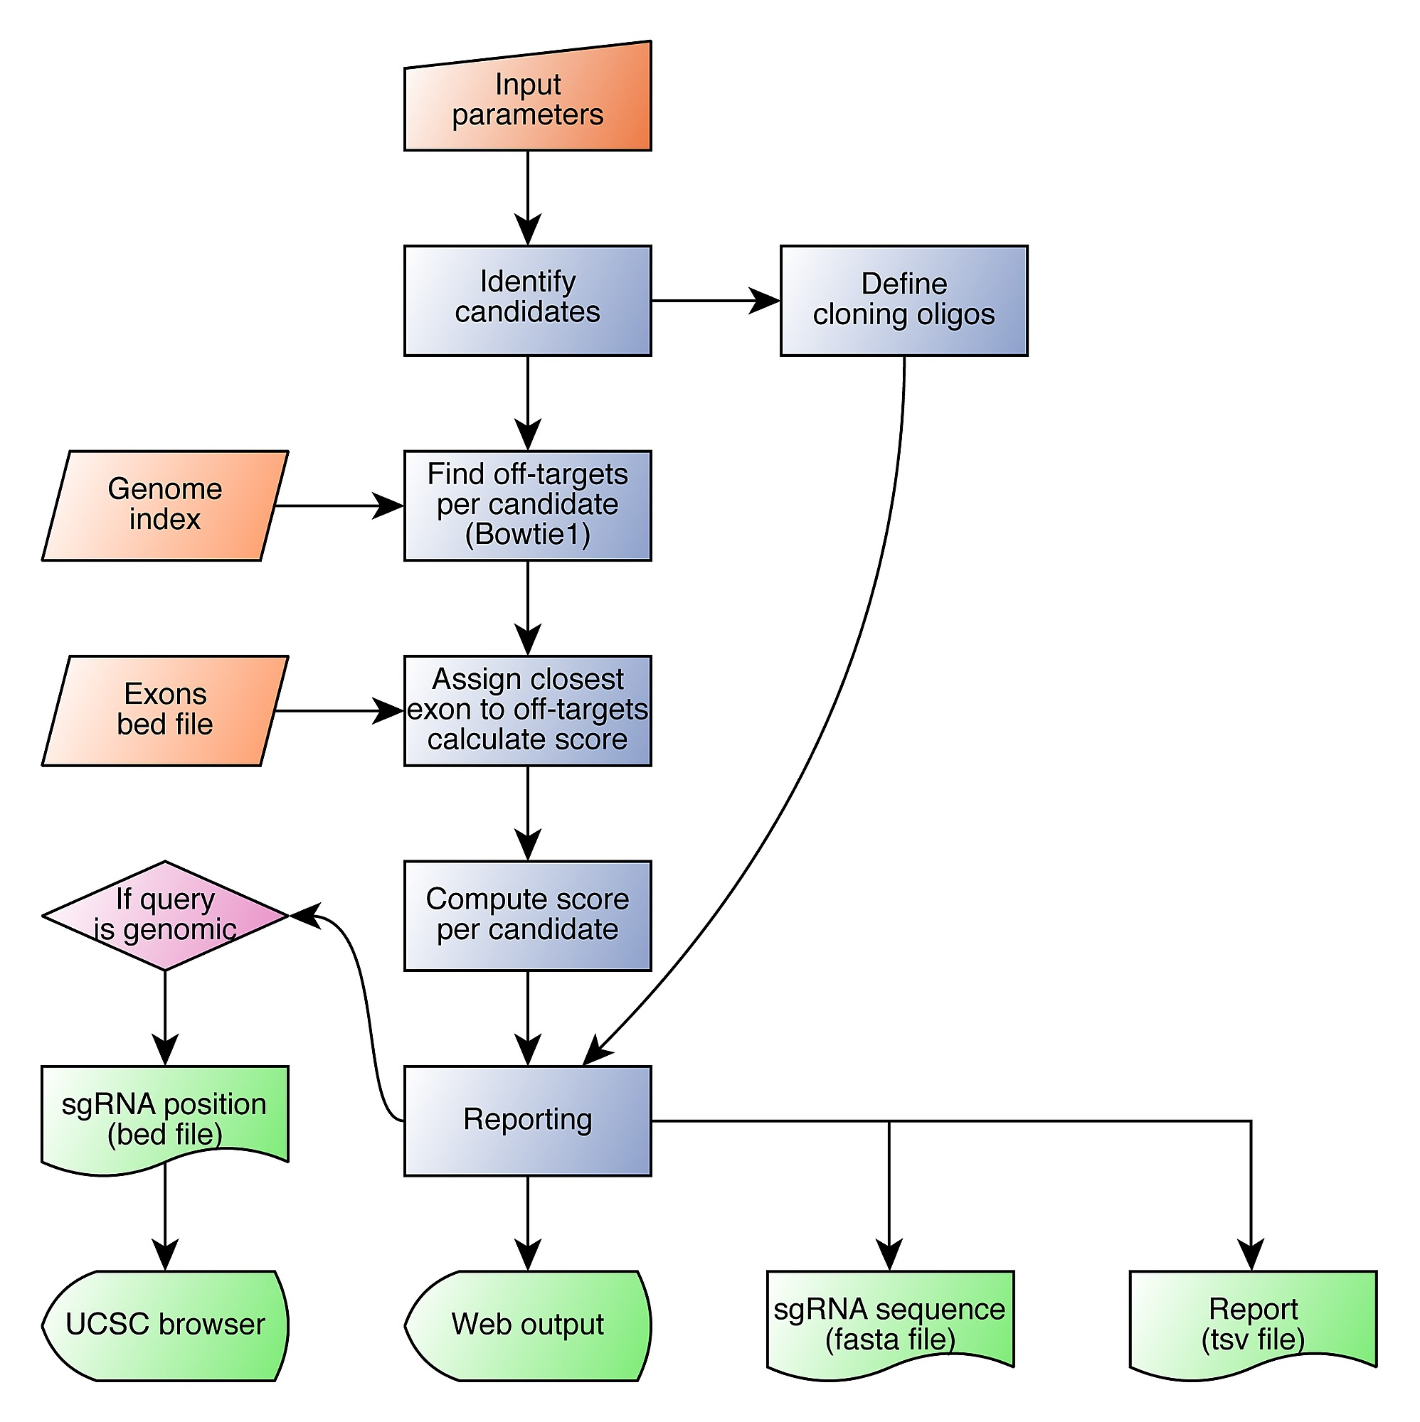
CCTop
Inputs: Sequence
On-Target Scoring: CRISPRater
Off-Target Scoring: Stemmer et al. 2017
Notes:
Experimental evidence indicates that Cas9 nuclease activity strongly correlates with the mismatch position along the sgRNA/DNA heteroduplex. Mismatches close to the PAM will most likely abolish the introduction of a DSB, while more distal mismatches are tolerated
We incorporate these findings as a simplified parameter, and define the nucleotides adjacent to the PAM as core sequence (12bp default length). More than two mismatches in that core abolish DSB introduction

Slide 17
Sequence determinants of improved CRISPR sgRNA design
2-step labeling: efficient and inefficient sgRNAs:
identifying genes whose deletion resulted in a growth disadvantage in genome-wide CRISPR/Cas9 knockout screens
sgRNAs were grouped into “efficient” and “inefficient” categories based on their decline in abundance in the screens
Notes:
Genes that can be easily diag
Group them

Slide 18
Gene Categories
ribosomal gene was targeted by more than 20 sgRNAs and each non-ribosomal gene was targeted by 10 sgRNAs
For the “ribosomal” set, 731 (35.3%) sgRNAs showed more than 2-fold depletion in both cell lines, thus were defined to be efficient.
438 (21.1%) failed to show significant differences from control sgRNAs that do not target any genomic locus, thus were defined to be inefficient
The remaining sgRNAs showed relatively weak effects in both cell lines or had significant effects in only one cell line, and were excluded from our analysis
non-ribosomal set: selected 671 efficient and 237 inefficient sgRNAs using the same criteria
Notes:
Ribosomal: Ribosomal DNA (rDNA) is a DNA sequence that codes for ribosomal RNA. These sequences regulate transcription initiation and amplification, and contain both transcribed and non-transcribed spacer segments.
Amplification: the process of increasing the volume of sound, especially using an amplifier.
Transcription is the process of copying a segment of DNA into RNA

Slide 19
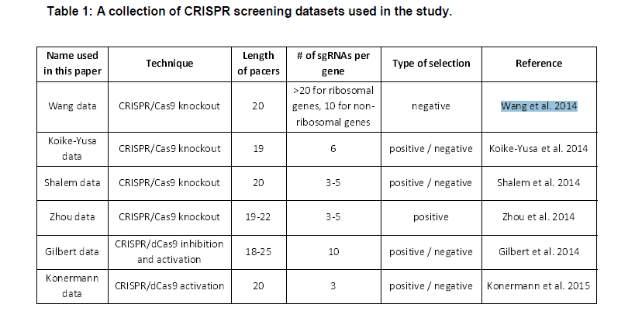
Gene Categories
mouse Embryonic Stem Cells (mESCs)
830 efficient and 234 inefficient sgRNAs

Slide 20
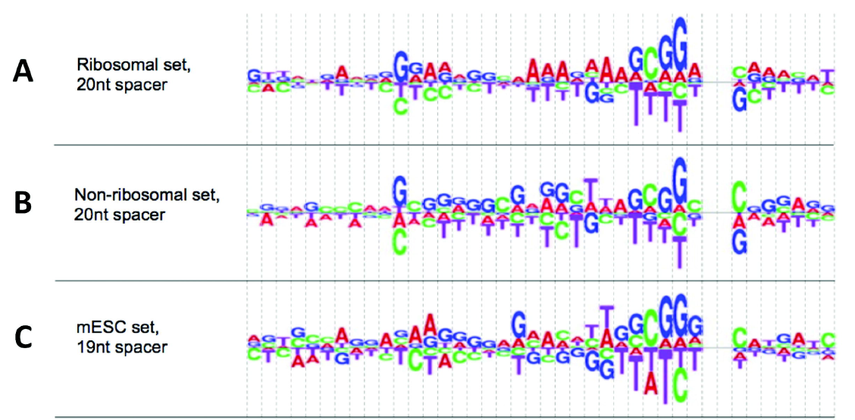
Sequence features
we computed the log odds-ratio of nucleotide frequency between DNA sequences targeted by efficient and inefficient sgRNAs

Slide 21
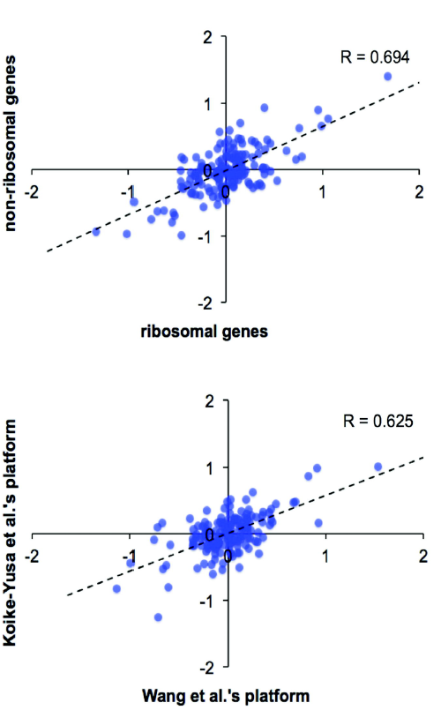
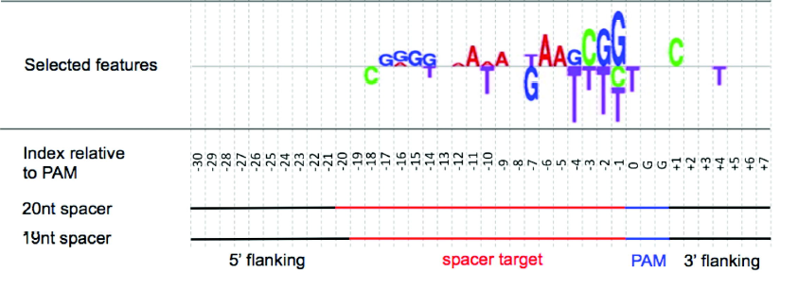
Sequence features
These sequences are 40-bp in length, including the 19-bp or 20-bp spacer targets as well as their 3’ and 5’ flanking DNAs
The log odds-ratios are correlated between the ribosomal and non-ribosomal sgRNA sets, as well as between the two libraries developed independently
The correlations indicate that many sequence features are robust against the variation of sgRNA designs, species and the spacer length

Slide 22
Reproducible Features
i) signs of the odds-ratios are concordant;
ii) magnitudes of the odds-ratios are above a threshold in all three sgRNA sets, where the threshold was computed from a statistical significance analysis
Applied Elastic-Net, a penalized linear regression model with proven utility in feature selection
(Zou and Hastie 2005).

Slide 23
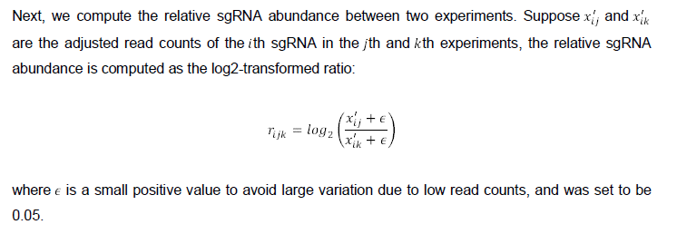
Pre-processing
N experiments performed on a set of M sgRNAs
the read count of sgRNA i on experiment jth is 𝑥_𝑖𝑗

Slide 24
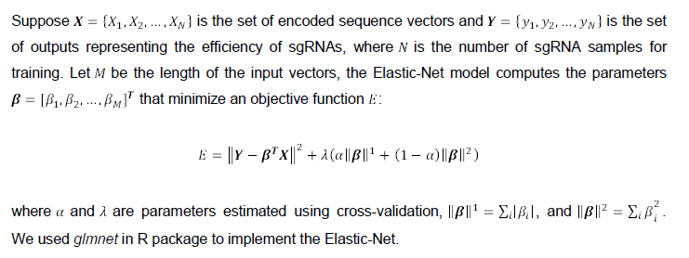
The Elastic-Net model

Slide 25
The Elastic-Net model
The predictor variable of Elastic-Net was a binary vector representing the presence or absence of the nucleotides selected based on the odds-ratio (1, -1)
The union of the three sgRNA training sets was used for Elastic-Net feature selection and parameter estimation.

Slide 26
Extracted Features
Identified 28 sequence features
Most features are located within the spacer region
Gs are strongly preferred at the -1 and the -2 positions to the PAM in CAS9
Ts are disfavored at the four positions closest to the PAM
the nucleotides downstream of the PAM contribute to sgRNA efficiency,
whereas the sequences upstream of the spacer have no significant effect
Notes:
First, guanines are strongly preferred at the -1 and the -2 positions proximal to
the PAM sequence, which are associated with the sequence preference in Cas9 loading (Wang et al.
2014). Second, thymines are disfavored at the four positions closest to the PAM, consistent with the
fact that multiple uracils in the spacer cause low sgRNA expression (Wu et al. 2014). Third, in line
with recent findings, the nucleotides downstream of the PAM contribute to sgRNA efficiency whereas the sequences upstream of the spacer have no significant effect (Doench et al. 2014).

Slide 27
Extracted Features
Cs are preferred at the -3 position in CAS9
As are preferred from position -5 to -12.
Gs are preferred at positions -14 to -17.
Notes:
cytosine is
preferred at the -3 position, which is the DNA cleavage site by the CRISPR/Cas9 complex (Cong et
al. 2013). This feature might contribute to the efficiency of cleavage or the introduction of mutation
upon DNA repair. Moreover, adenines are preferred from position -5 to -12, and guanines are
preferred at positions -14 to -17.

Slide 28
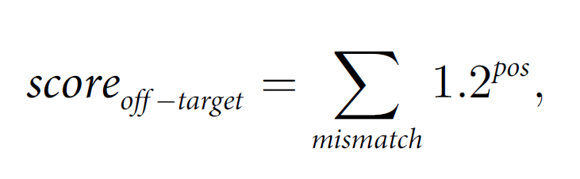
Off-target mismatch score
where pos is the position of each mismatch, counted from the 5’ end. The base of the power expression was determined empirically

Slide 29
Assignment of closest gene to off-target sites
Only exons closer than 100kb to the predicted off-target sites are assigned, otherwise “NA” is given as output. If target site and exon coordinates overlap, the distance is assigned to 0.

Slide 30
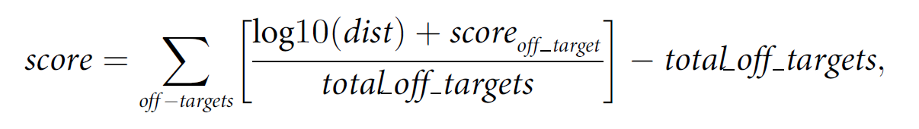
sgRNA target site score

Slide 31
Deep Learning and Crisper

Slide 32
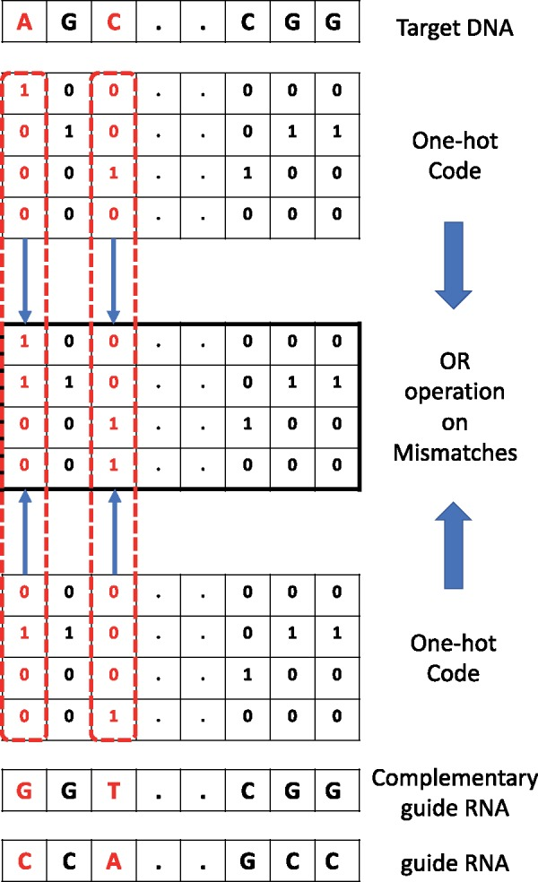
DNA Sequence as an image

Slide 33
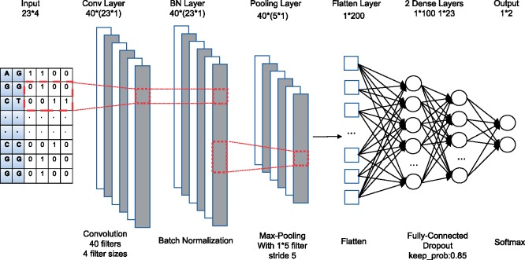
CNN

Slide 34
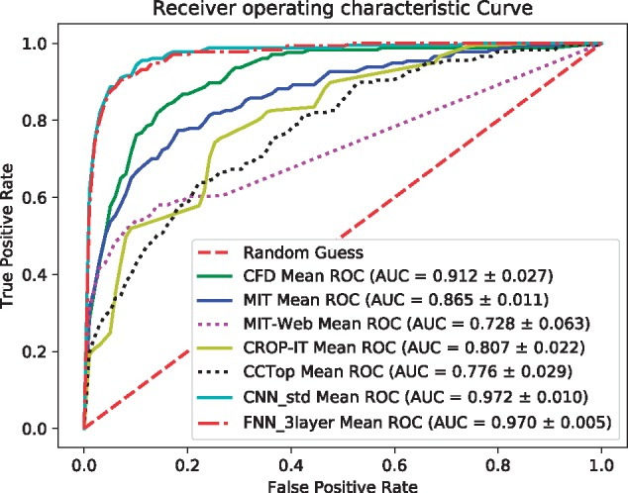
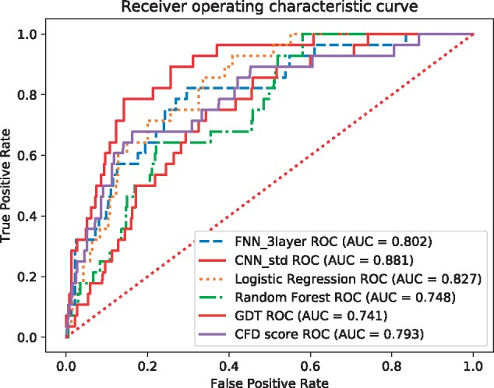
DL vs ML
DL vs Famous off-target methods

Slide 35
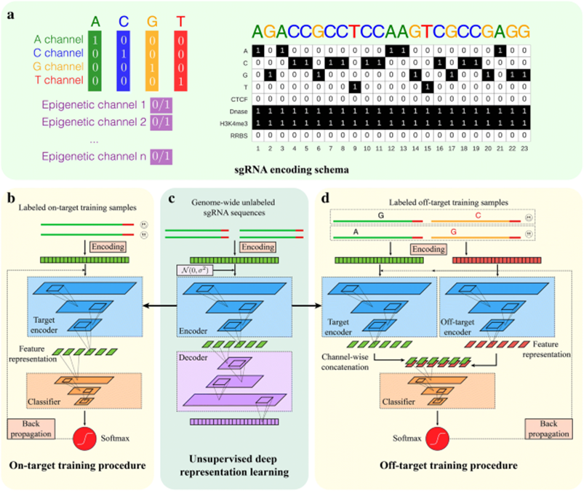
DeepCRISPR
In a paper named DeepCRISPR, the authors were convinced that good predictions can be made only by sgRNAs themselves.
A DCDNN-based autoencoder was made by 0.68 billion samples
Then the extracted features were used in deep models for prediction of efficiency score and classification
They yield good result with only sgRNA sequence and beat state-of-the-art by adding epigenetic information
Notes:
epigenetics is the study of heritable phenotype changes that do not involve alterations in the DNA sequence.
stably heritable phenotype resulting from changes in a chromosome without alterations in the DNA sequence

Slide 36
Methods
Notes:
What We Learned? 1. ML Helpful, 2.Seq was usually for Off-targets mostly, 3. Regression for Efficiency

Slide 37
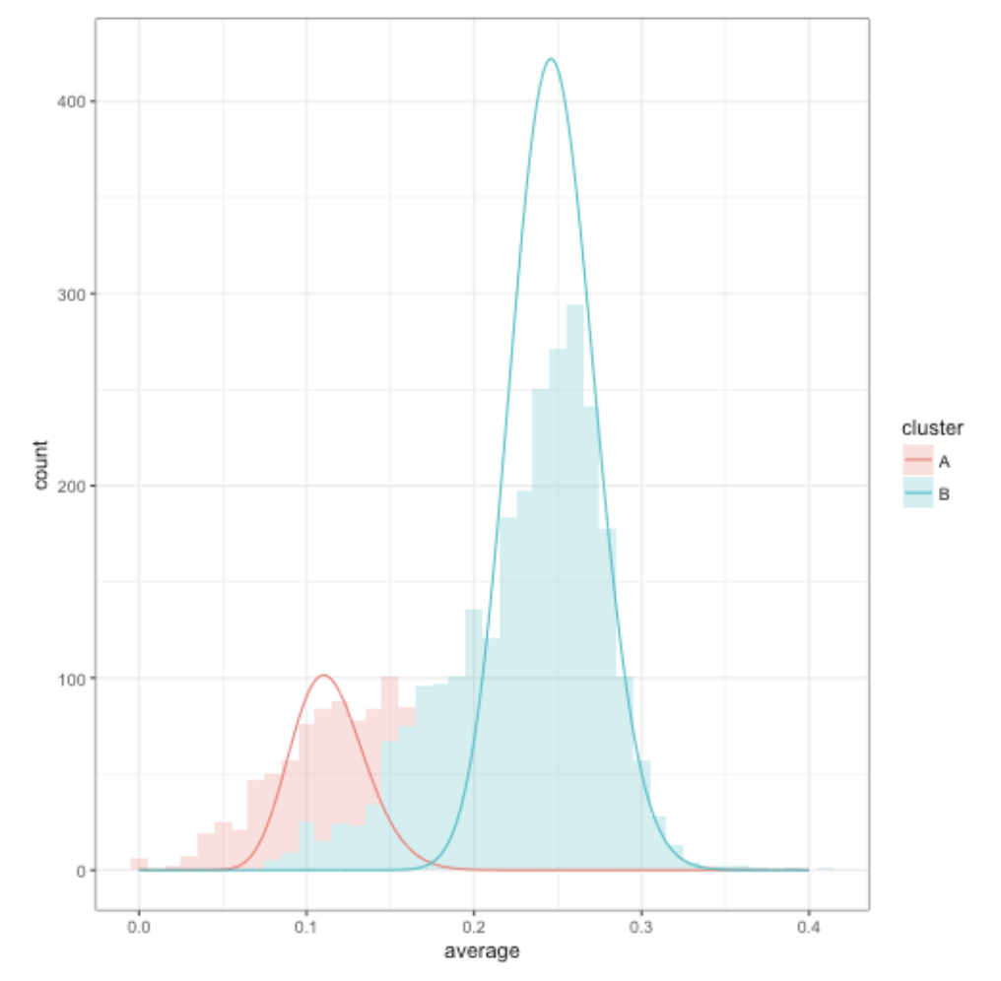
Latent Profile Analysis and Ensemble
Notes:
i.i.d, classes variables are independent, probabilistic latent semantic analysis and non-negative matrix factorization.

Slide 38
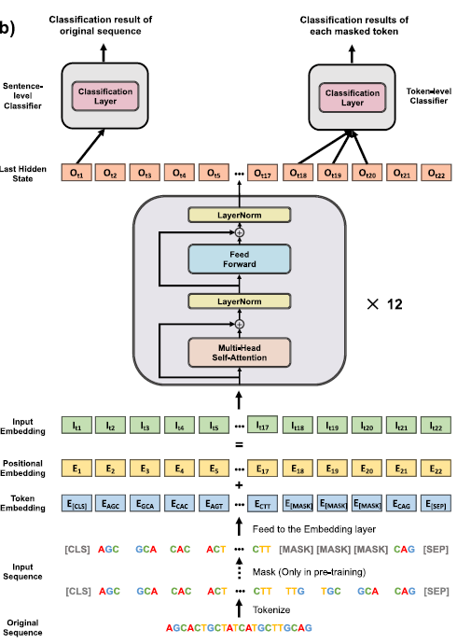
Attention-based Models

Slide 39
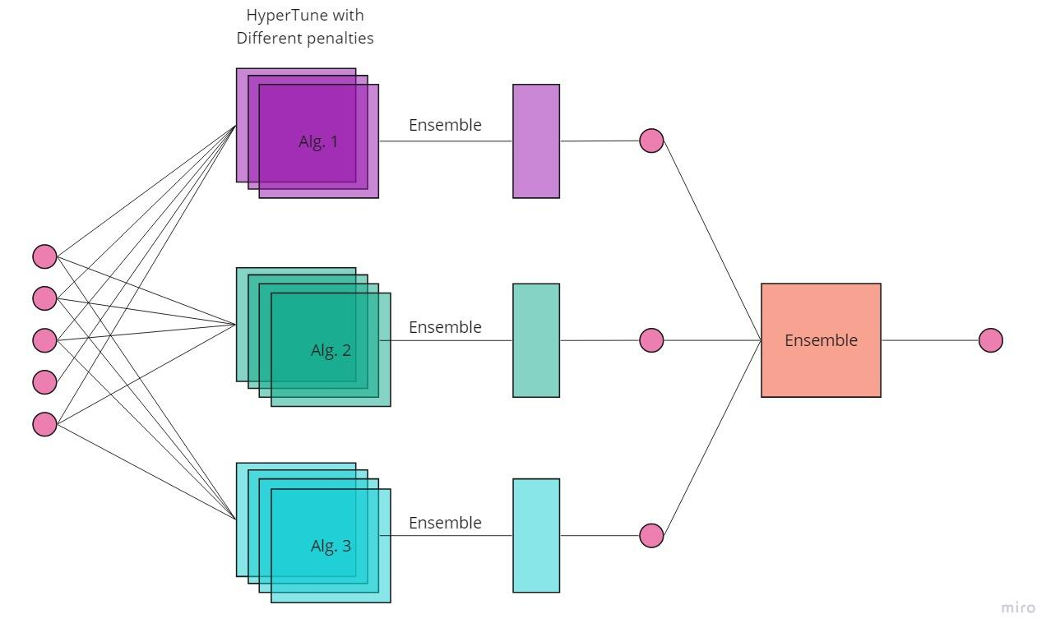
Our Method

Slide 40
Results

Slide 41
Data Gathering
We gathered 5 methods with similar input and outputs for knockout with a NGG PAM.
We Gathered 43GB of data (sgRNA for 2705 seq and their off-targets )
All the sequences are from Homo Sapiens hg38

Slide 42
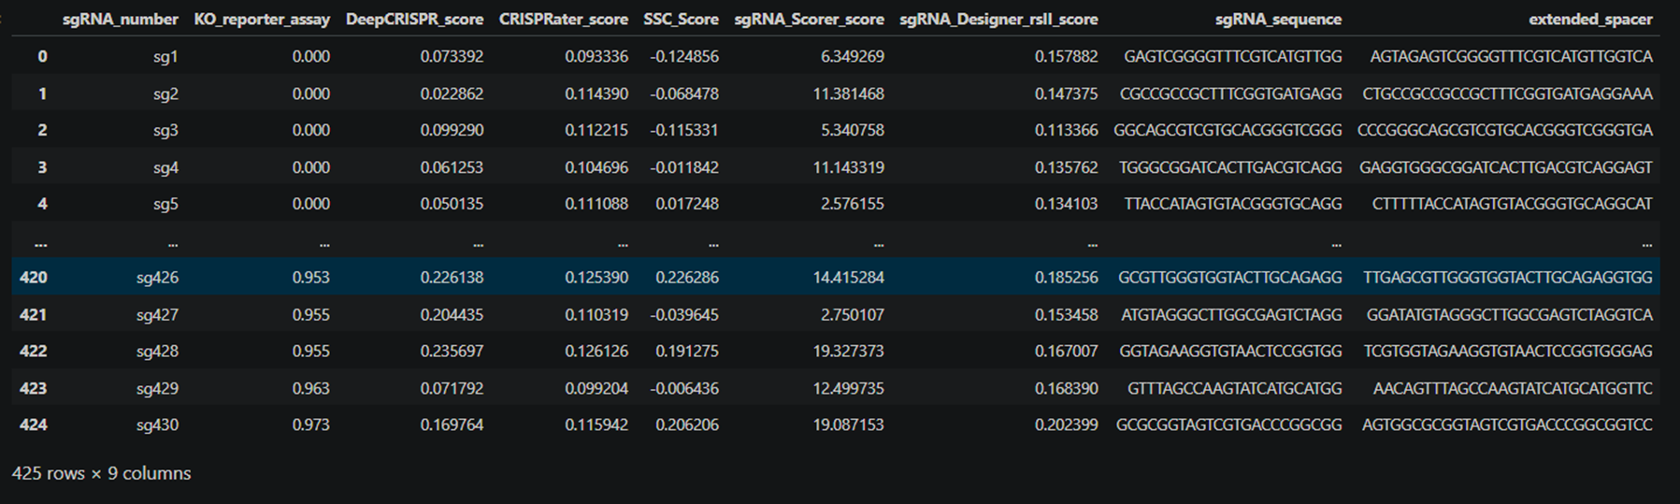
Data
We made table with score and rankings similar to this

Slide 43
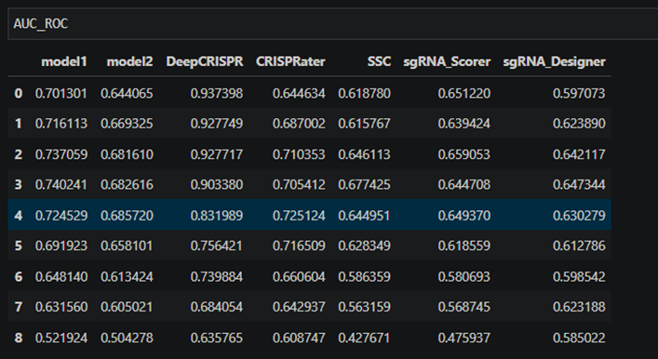
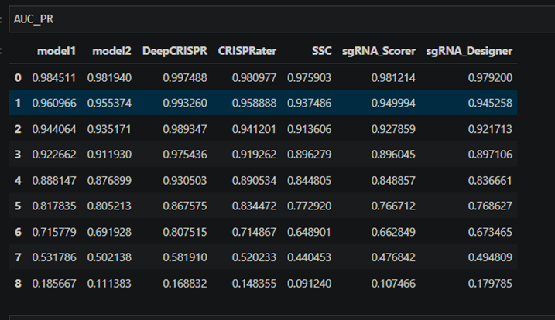
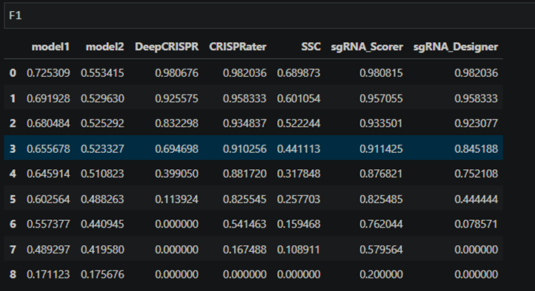
This are some of the results respective to a threshold respective to KO_reporter_assay
Several ensemble learning methods and Latent class analysis was used to mix the models but no good results was achieved.
We concluded that this was the result of methods having vastly different opinion on some points and concluded that mixture of models will not yield better results

Slide 44
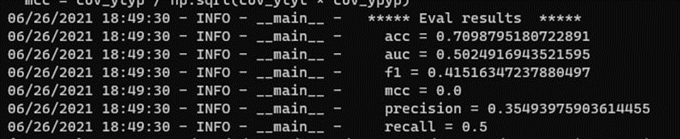
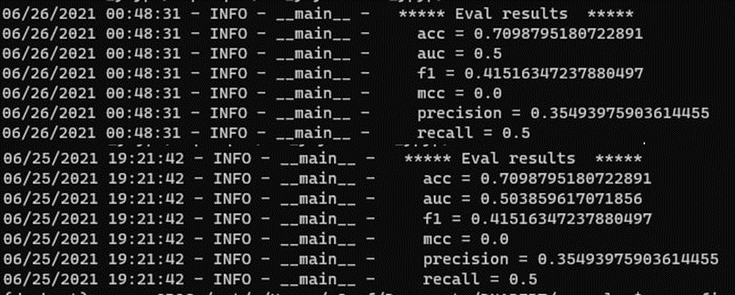
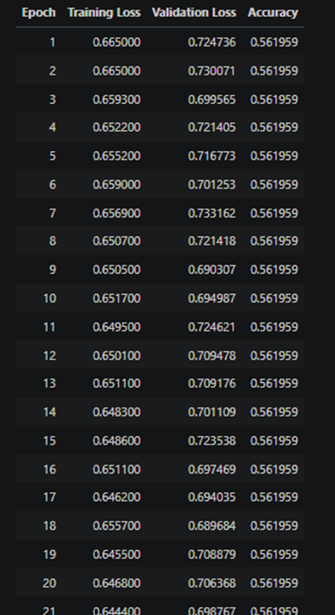
Attention-based
Our Idea was to replace the encoder with attention mask
We gathered around 1 million unlabeled sgRNAs
And Used the labeled sgRNAs from DeepCRISPR (3 cell line’s sgRNAs)
We used a couple of a model name DNAbert as pretrain model
And pretrained a couple of Attention models ourselves(Bert, Robertabert, etc)

Slide 45
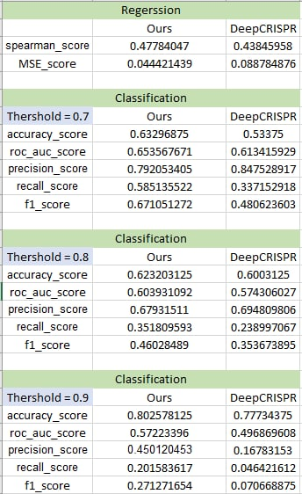
Our Method

Slide 46
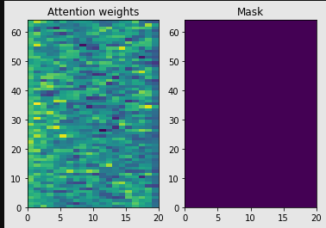
Problems
Unlabeled sgRNAs have noise or maybe not enough (all possible sgrna 4^21)
Labeled sgRNAs have noise
sgRNAs are small sequences so not much attention mask is learned
Adding other features is not possible

Slide 47
Discussion
Define our own efficient and inefficient sgRNA
Directly use features with Our Method
Maybe seeing the unlabeled data as an image can help reduce noise
Nosie label reductions techniques. Require unlabeled sgRNAs without noise
Extending the sequence by techniques similar to DNAbert (meaningful repetition of the seq)
Finding better datasets

Slide 48
Thank You for Listening

